Slide 1

DOM Manipulations
01
02
Document Object Model
03

Slide 2
Content
01
BOM & DOM
02
DOM API
03
Exercises

Slide 3
01
BOM & DOM
Browser & Document Objects

Slide 4
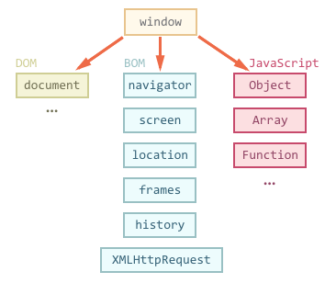
Browser Object Model (BOM)
Browsers uses some objects: window, screen, history, location, document, etc.
console.dir(window);
console.dir(screen);
console.dir(location);
console.dir(history);
console.dir(document);

Slide 5
Document Object Model
Represents the document as nodes and objects
can connect to the page
The DOM is an Object Model for HTML.
Defines:
HTML elements as objects
Properties
Methods
Events

Slide 6
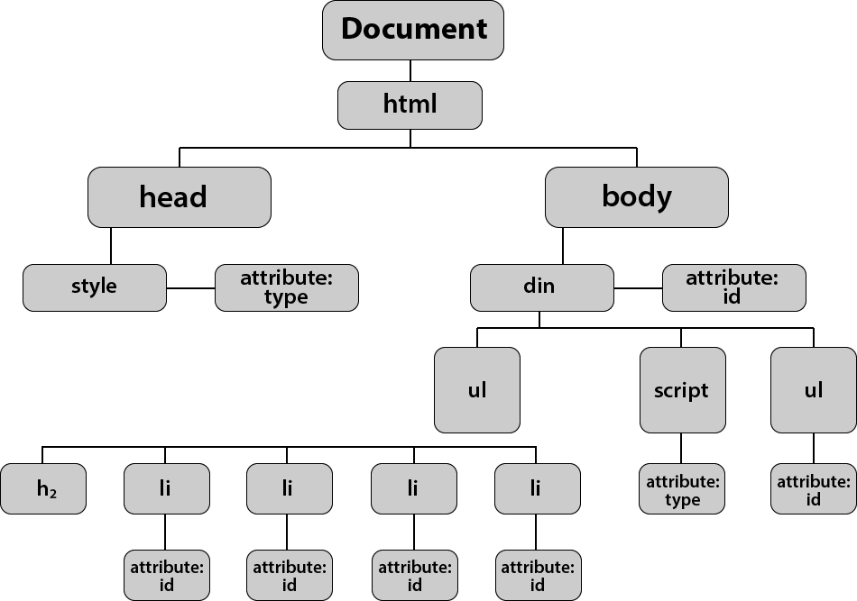
HTML to DOM Tree
The browser parses HTML and creates a DOM Tree.
<html>
<head>
</head>
<body>
<div id="asd">
<ul>
</ul>
</div>
</body>
</html>

Slide 7
Methods & Properties
DOM Methods - actions you can perform on HTML elements
DOM Properties - values of HTML elements that you can set or change
let el = document.getElementById('id');
console.log(el);
el.innerHTML += 'hello';

Slide 8
02
DOM API
Using the DOM API

Slide 9
DOM API
JavaScript can interact with web pages:
Check the contents and structure of elements on the page
Modify element style and properties
Read user input and react to events
Create and remove elements
Actions are performed when an event occurs
Events are triggered when something happens - page is loaded, button is clicked etc.

Slide 10
JavaScript in the Browser
JS is executed in the :
In the developer console
As event handler – user clicks on a button
With inline script in <script> tags of external file
<button onclick='console.dir("Hello")'>CLICK</button>
<script>
function sum(a, b){ return a + b; }
</script>

Slide 11
HTML Elements and Properties
The DOM Tree consists of HTML elements
Elements are JS objects with properties and methods
can be accessed and modified like regular objects
To change the contents of the page:
Select an element to obtain a reference
Modify its properties

Slide 12
Attributes and Properties
Attributes are defined by HTML
Attributes initialize DOM properties
Property values can change via the DOM API
The HTML attribute and the DOM property are NOT the same

Slide 13
Targeting Elements
To find a certain HTML element in the DOM:
By ID - getElementById()
By class name - getElementsByClassName()
By tag name - getElementsByTagName()
By CSS selector - querySelector(), querySelectorAll()
Return a reference to the element, which can be manipulated using JavaScript

Slide 14
Targeting Elements
Targeting by ID - ID attribute must be unique
Targeting by Tag and Class Names
Both methods return a live HTMLCollection
let element = document.getElementById('someId');
let elements = document.getElementsByTagName('p');
let elements = document.getElementsByClassName('cl');

Slide 15
CSS Selectors
Strings that follow CSS syntax
Allow very fast element matching:
"#store" - returns the element with ID "store"
"#main div" - selects all <div>s inside #main
".list, .alert" - all elements with class "list" or "alert"
"input[name='email']" - <input> with name "email"
let mainDiv = document.querySelector('#main');
// selects the element with id main.
let elements = document.querySelectorAll('div.list');
// selects all <div> elements having a class named 'list'

Slide 16
Parents and Child Elements
Every DOM Element has a parent
Parents can be accessed by property parentElement or parentNode
<div>
<p>Paragraph</p>
<p>Second</p>
</div>
let firstP = document.getElementsByTagName('p')[0];
let pElements = document.getElementsByTagName('div')[0].children;

Slide 17
External Page Scripts
Page scripts can be loaded from an external file
Functions from script files are in the global scope
Can be referenced and executed from events and inline scripts
Multiple script files in a page can access each other
Pay attention to load order!!!
<script src="main.js"></script>

Slide 18
Exercises
https://developer.mozilla.org/en-US/docs/Web/API/Document_Object_Model
https://www.jschallenger.com/javascript-dom-exercises

